Slide 1

Image Steganography
Art of hiding data in plain sight!
By Ashish Gupta

Slide 2
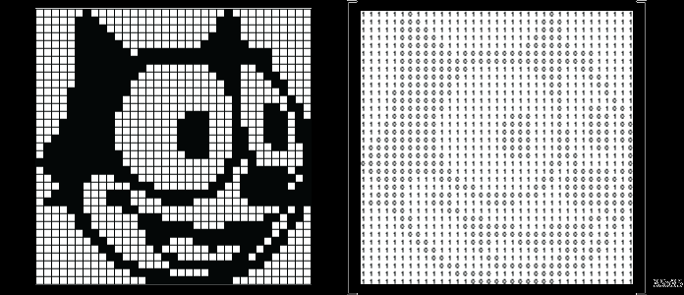
What are images?
Number matrices ( Eg. 600 * 600)
Each number → Color intensity.
2 types:
GrayScale ( 600*600*1)
Colored (600*600*3) where 3 represents each of red, green, blue

Slide 3
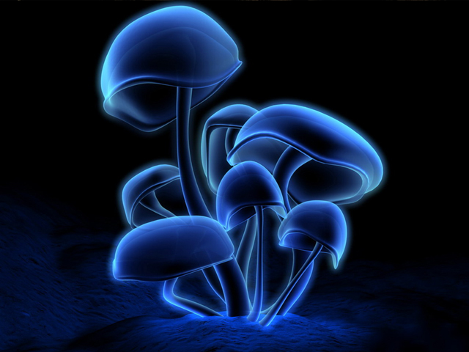

This image has no data
This Image has a book inside.

Slide 4
But they look the same?
This is exactly why data is hidden into an image!!!
Lets define Steganography...

Slide 5
Steganography
Is hiding that image has data, so that no hacker can know where data is?
Cryptography
Assumes data is with hacker but is unreadable!

Slide 6
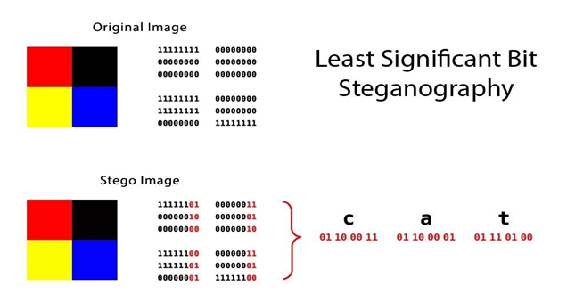
Step 1: Putting data into image
Each pixel is stored as binary
Convert message to binary (Ex CAT in the image → )
Select numbers of image one by one and convert them to binary
Take 2 bits from message at a time and store these 2 bits into last positions of image binary numbers.
Done!

Slide 7
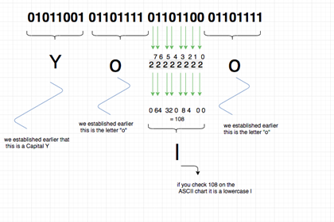
Step 2: Extracting Data
Read the image numbers one by one and convert to binary.
Take the 2 bits and append them as a string
Read the whole string as Ascii characters taking 8 bits at a time.
Ex(11000011100001→ AA(1100001 + 1100001))

Slide 8
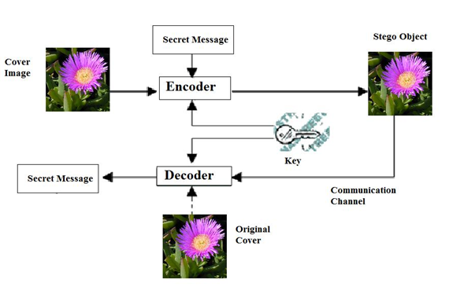
Whole Process

Slide 9
Let’s get into live action!
We will encrypt entire text of Harry Potter - Part 1 in a mushroom’s image!

Slide 10
Conclusion
Thus data can be hidden in plain sight from the unauthorised user and can be delivered anywhere across the globe. Steganography is the way to maintain secret communication between 2 parties.
Some applications include:
Secret medical data of celebrities.
Password database of a company.
Secret project reports, contract papers etc.
Other infinite solutions being researched!

Slide 11

Thank You! (Questions?)

